Slide 1
Introduction to Cassandra API in Azure Cosmos DB
Speaker
Role
Twitter @

Slide 2
Agenda
A quick intro to the Azure Cosmos DB service
The benefits of using Cassandra API in Azure Cosmos DB
An explanation of Request Units in Azure Cosmos DB
Some special features that are unique to Cassandra API

Slide 3

what is Azure Cosmos DB? Fast NoSQL database with open APIs for any scale
Azure Cosmos DB is a fully managed NoSQL database for modern app development with SLA-backed speed and availability, automatic and instant scalability, and open source APIs for MongoDB, Cassandra, and other NoSQL engines.
Guaranteed speed at any scale
Simplified application development
Mission-critical ready
Fully managed and cost-effective
Guarantee business continuity, 99.999% availability, and enterprise-level security for every application.
End-to-end database management with serverless and automatic scaling matching your application and TCO needs.
Gain unparalleled SLA-backed speed and throughput, fast global access, and instant elasticity.
Build fast with open source APIs, multiple SDKs, schemaless data, and no-ETL analytics over operational data.
Notes:
So what is Azure Cosmos DB? It’s a fully managed NoSQL database for modern app development with SLA-backed speed and availability, automatic and instant scalability, and open source APIs for MongoDB, Apache Cassandra, and other NoSQL engines.

Slide 4
So, what is the Cassandra API in Azure Cosmos DB?
Notes:
So, what is the Cassandra API in Azure Cosmos DB? (click)
Cassandra API is one of a number of interoperability APIs in Azure Cosmos DB.
The idea is that you can use any Apache Cassandra client drivers to connect to the API (click)
This can be any open source driver (click), Java, .NET, Node.js, or whatever you want.
If you have an existing Cassandra app, switching to the Cassandra API can be as easy changing connection string (click).
However (click) this does depend on feature supportability (show wire protocol docs).

Slide 5

So, what is the Cassandra API in Azure Cosmos DB?
Change of connection string*
Your app
Your application
Apache Cassandra client driver
Your app logic
MongoDB API
Cassandra API
Any other API …
* Depending on feature supportability
Open-source driver of choice, Java, .NET, Node.js, etc*
Notes:
So, what is the Cassandra API in Azure Cosmos DB? (click)
Cassandra API is one of a number of interoperability APIs in Azure Cosmos DB.
The idea is that you can use any Apache Cassandra client drivers to connect to the API (click)
This can be any open source driver (click), Java, .NET, Node.js, or whatever you want.
If you have an existing Cassandra app, switching to the Cassandra API can be as easy changing connection string (click).
However (click) this does depend on feature supportability (show wire protocol docs).

Slide 6
Great Question ☺
If Cassandra API does not support all the native features, why not just use native Apache Cassandra?
No operations management
Supports most Apache Cassandra + PaaS benefits
Throughput and storage elasticity – with autoscale!
Global distribution, 99.999% availability.
Enterprise grade
Azure Cosmos DB free tier! ☺
Unique Features!
Notes:
At this point, you might be thinking “if Cassandra API does not support all the native Apache Cassandra features, why would I choose it instead of the native Apache Cassandra?” (click)
Great question (click)
First of all, its a fully managed cloud service, and removes the overhead of managing and monitoring Cassandra clusters…which can be a pain (click)
Secondly, although it doesn’t support everything, still supports a large surface area of the native Apache Cassandra, and you still gain all the benefits of a managed platform. (click)
Thirdly, Cosmos DB provides guaranteed throughput across all regions, and users can scale provisioned throughput manually, programmatically, even automatically using the autoscale feature.
Fourthly Azure Cosmos DB provides the ability to globally distribute data across all Azure regions. You can serve data locally while ensuring low latency and 99.999% read and write availability across multiple regions with no operations overhead. This is very hard, if not impossible, to achieve with a native Apache Cassandra implementation.
The fifth reason is that Cosmos DB provides compliance certifications to ensure users can use the platform securely. Azure Cosmos DB also provides encryption at rest and in motion, IP firewall, and audit logs for control plane activities.
The sixth reason is - Azure Cosmos DB free tier! You get a small amount of capacity and storage, but you can run small production workloads. Remember, this is NOT just free software – it is free infrastructure as well! If you are a start-up, or you just want to start small in a POC phase, think about how much it would otherwise cost you to put Apache Cassandra on a VM in any cloud
Finally, Cosmos DB has a bunch of unique features that don’t lock you in, but at the same time, you cannot have them in Apache Cassandra! (click) I hope you will stay tuned to find out… what these are ☺

Slide 7
Let’s take a look at creating a Cassandra API account in Cosmos DB First ☺
Notes:
But let’s take a look at creating a Cassandra API account in Cosmos DB First (demo of creating account, and portal shell).

Slide 8
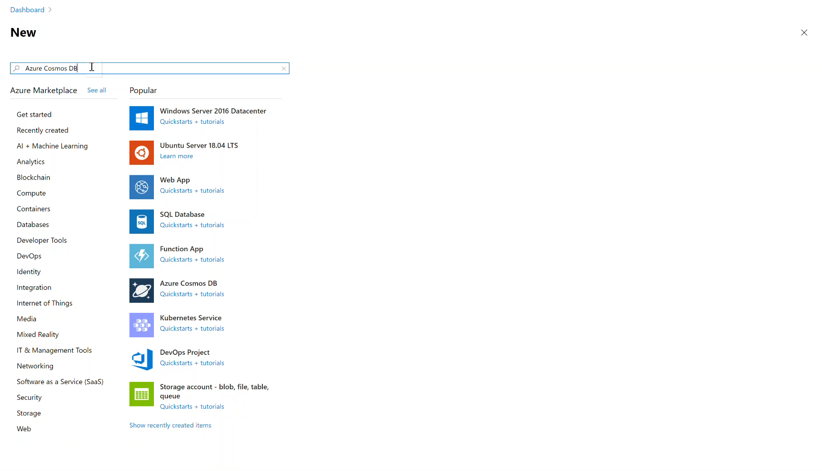

Slide 9
Introducing Request Units (RUs)
“Expected performance” is expressed in Request Units per second (RU/s)
Represents the "cost" of a request in terms of CPU, memory and I/O
RUs can be provisioned to suit different levels of performance isolation:
at the keyspace-level
at the table-level
or both
Provisioned performance can be changed programmatically with API calls
Let autoscale do it ☺
Notes:
Lets intrduce request units at this point (click)
In Cosmos DB, expected performance is expressed as Request Units per second (or Rus), which represent the cost of a request in terms of CPU, memory, and I/O. In other words, they are a single unit of abstraction for these physical resources, that are intended to simplify the provisioning of performance in terms of how many reads or writes per second you expect to get. (click)
Performance can be provisioned to suit different levels of performance isolation:
at the keyspace-level
at the table-level - you saw me do this just now (click)
or both (click)
Provisioned performance can be changed programmatically with API calls (click)
And last but not least, you can let autoscale do it - note that you can also change the max autoscale programmatically too (click) if the minimum and maximum ranges don’t suite your needs.
So you can see this gives you a lot of options to elastically scale your Cassandra API account in Cosmos DB

Slide 10
So what about these unique features? ☺
Notes:
So what about these awesome features you promised me?

Slide 11


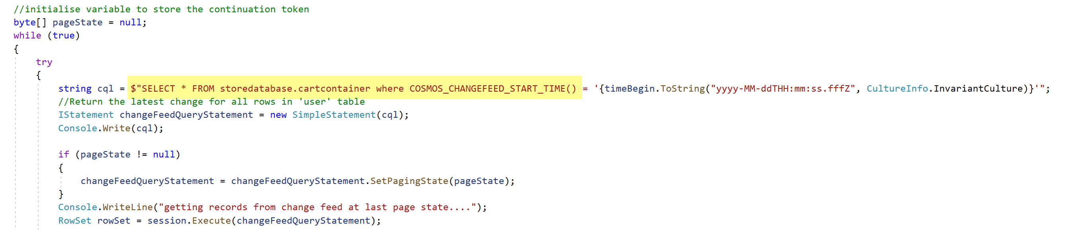
Change Feed
Persistent Event Store
Microservice
#1
New Order
Read From Change Feed using CQL
Microservice #2
Notes:
In Cosmos DB have something we call the change feed, which is leveraged by Cassandra API (click)
In any database, you are going to have a variety of changes (click) coming into the system
Cosmos DB has a distributed persistent event store (click), which acts as a log of changes (click) that can come into any given table.
Now you may have other services (click), or other downstream processes that need to sync the data. You can think of the event store in Cosmos DB like the Change Data Capture (or CDC) log in Cassandra. However, unlike Cassandra (click)
we expose a programming model that allows you to read events from the change log from any point in time using the Cassandra Query Language (click). This works using a pull model in which the Cassandra API maintains a paging state (double click), and Cassandra clients can fetch the next batch of changes using a SELECT statement and the previous paging state

Slide 12
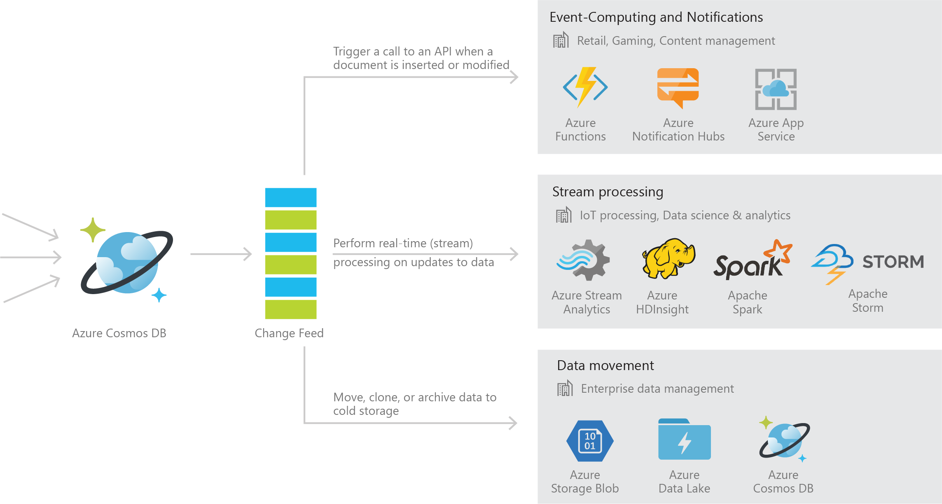
Change Feed
Notes:
The typical use cases for this, event computing and notifications, stream processing, and data movement.

Slide 13
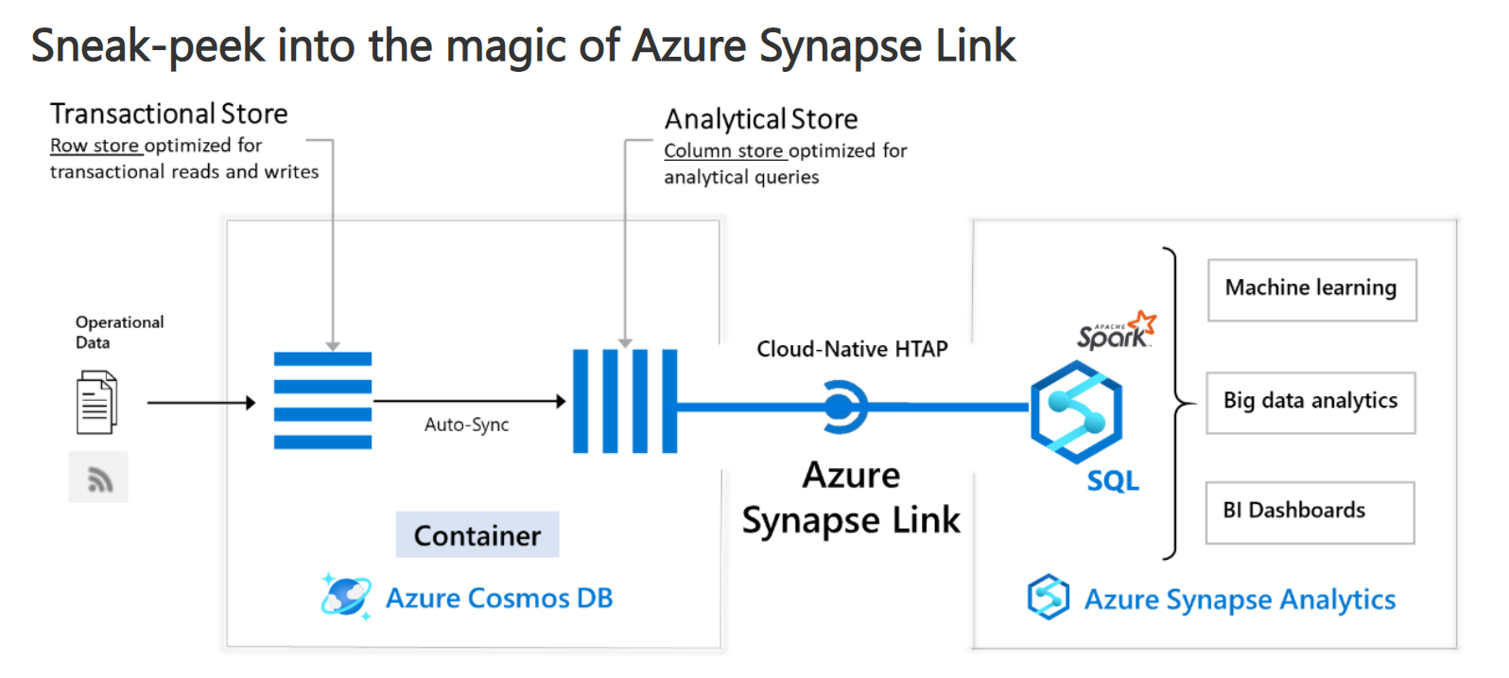
Real-time, no-ETL analytics at scale with Azure Synapse Link for Azure Cosmos DB
Notes:
Well, yes, you can! With Azure Synapse Link for Cosmos DB, we provide a built-in analytical store that is fully isolated from the transactional store such that queries over the analytical store have no impact on your transactional workloads. Updates to the operational data are automatically synchronised from transactional store to the analytical store in near real-time, within minutes. This capability is nowhere to be found in a native Apache Cassandra implementation.

Slide 14
Thank you!!

